Slide 1

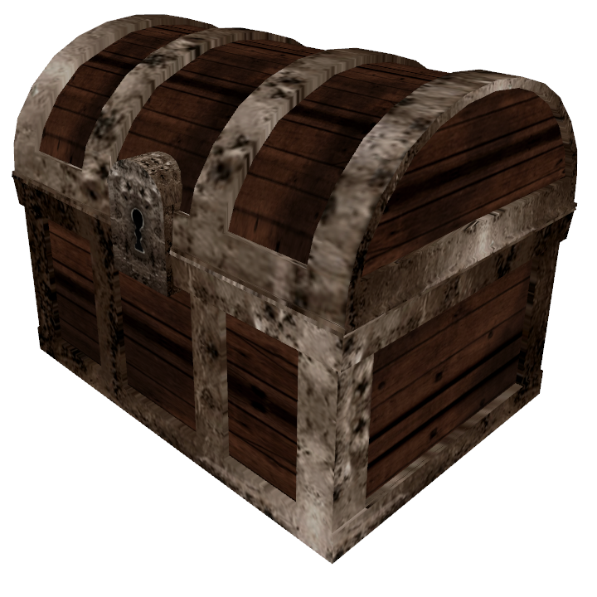
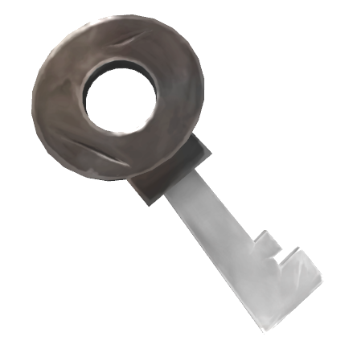
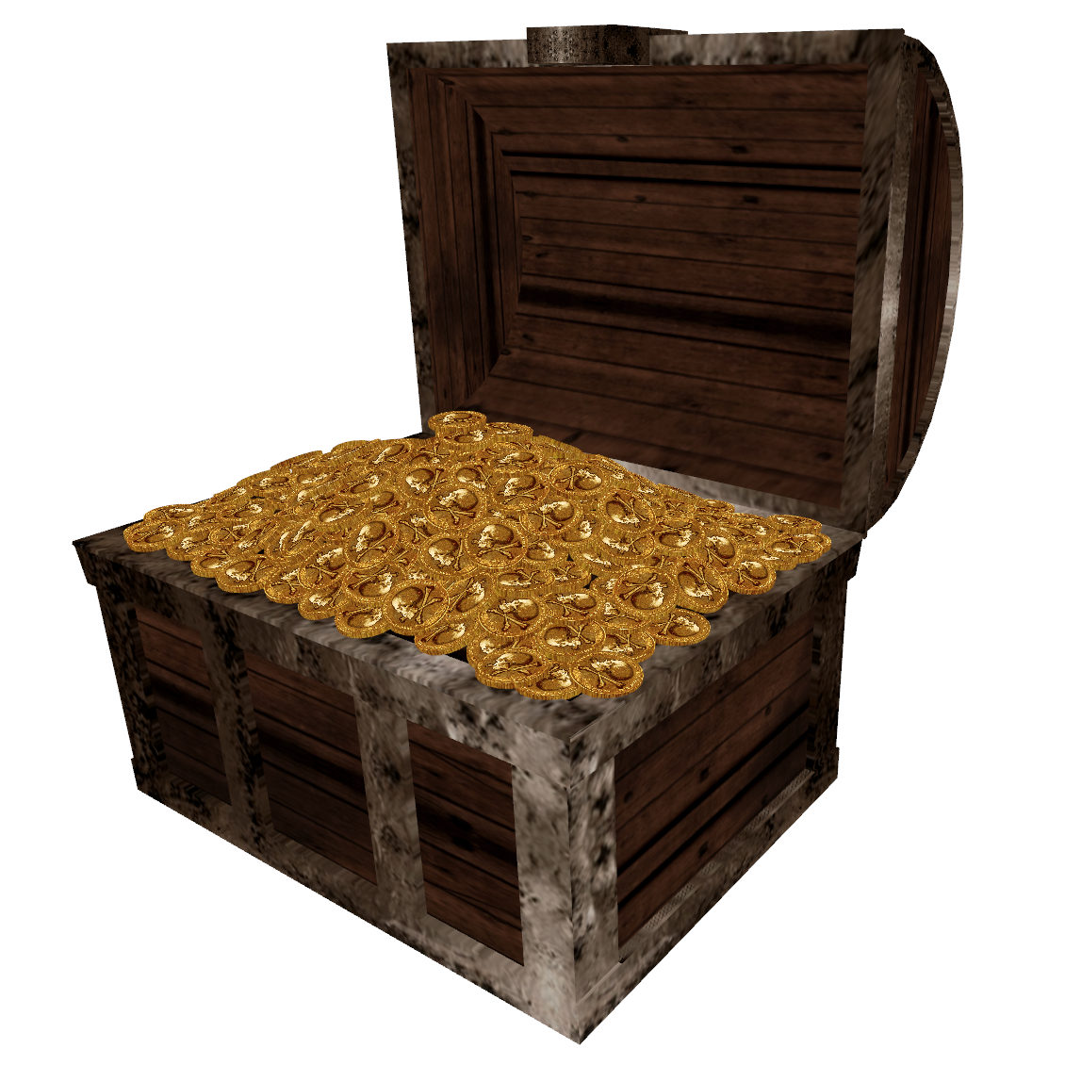

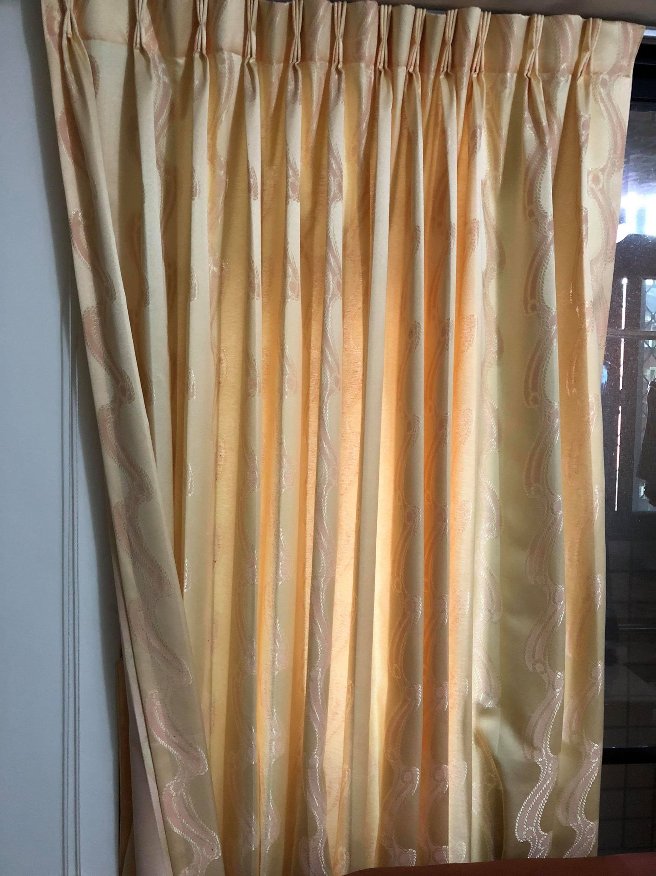
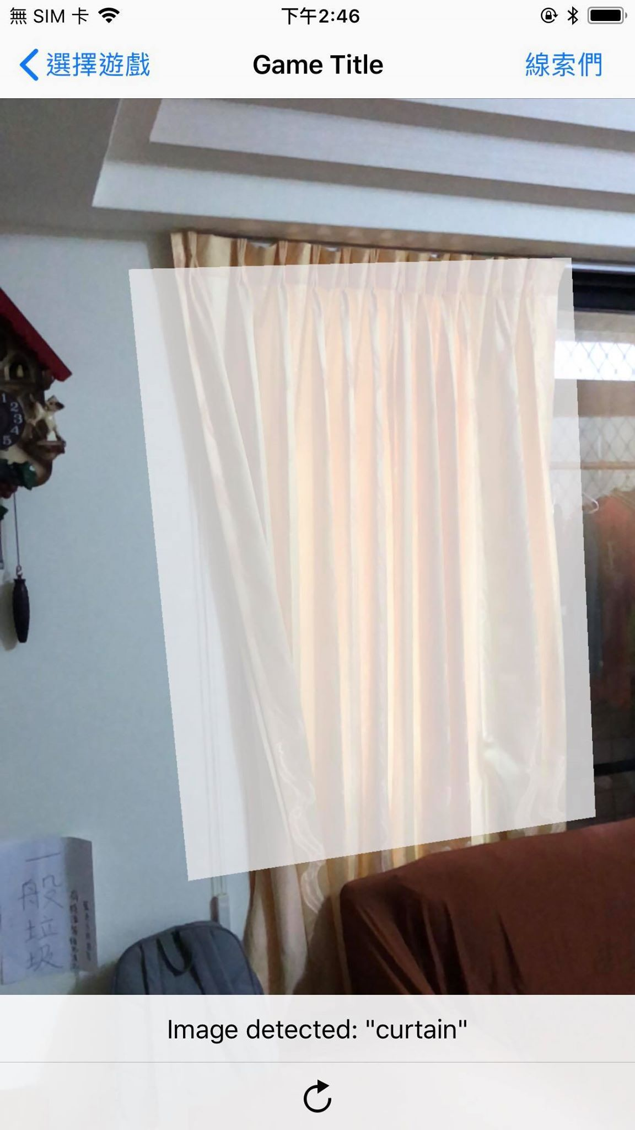
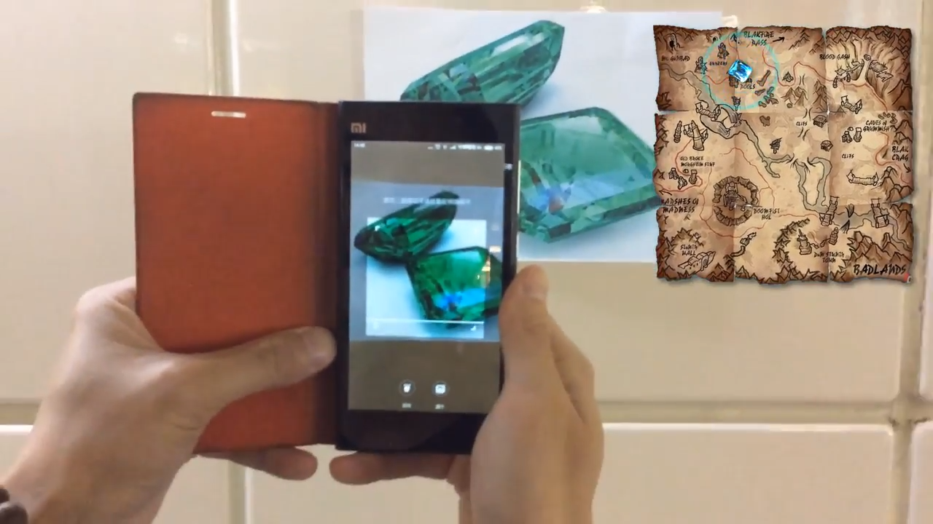
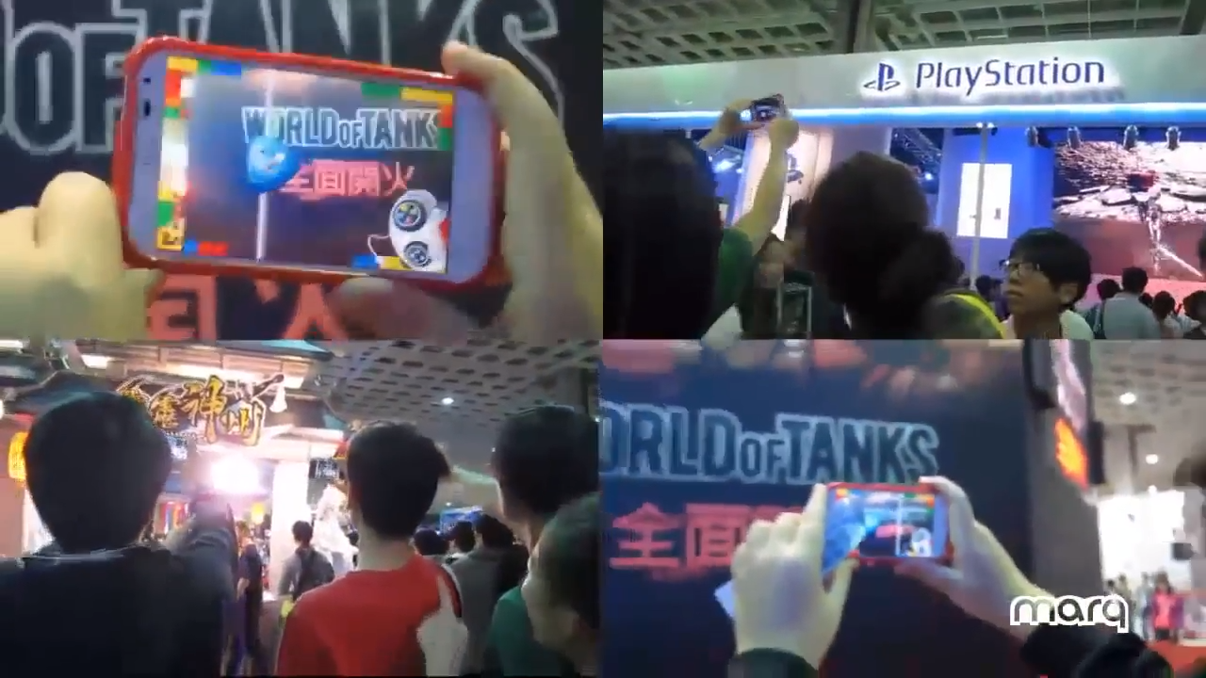
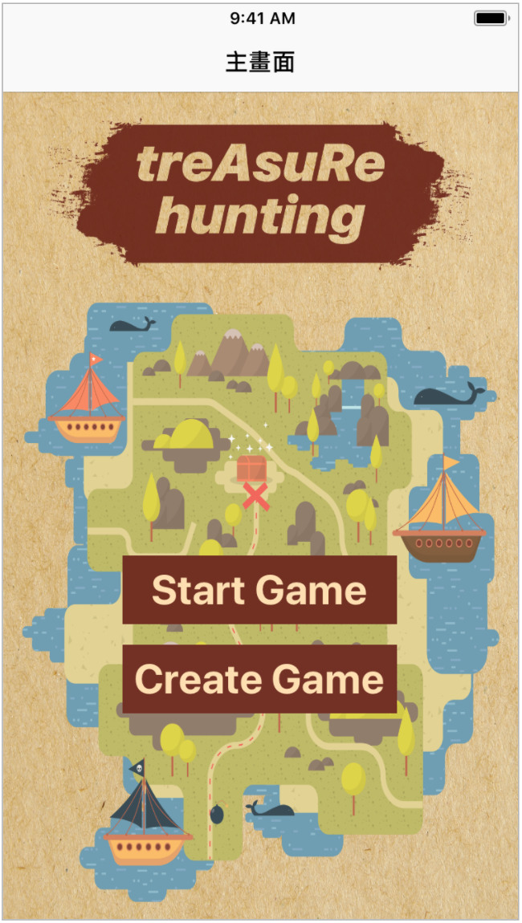
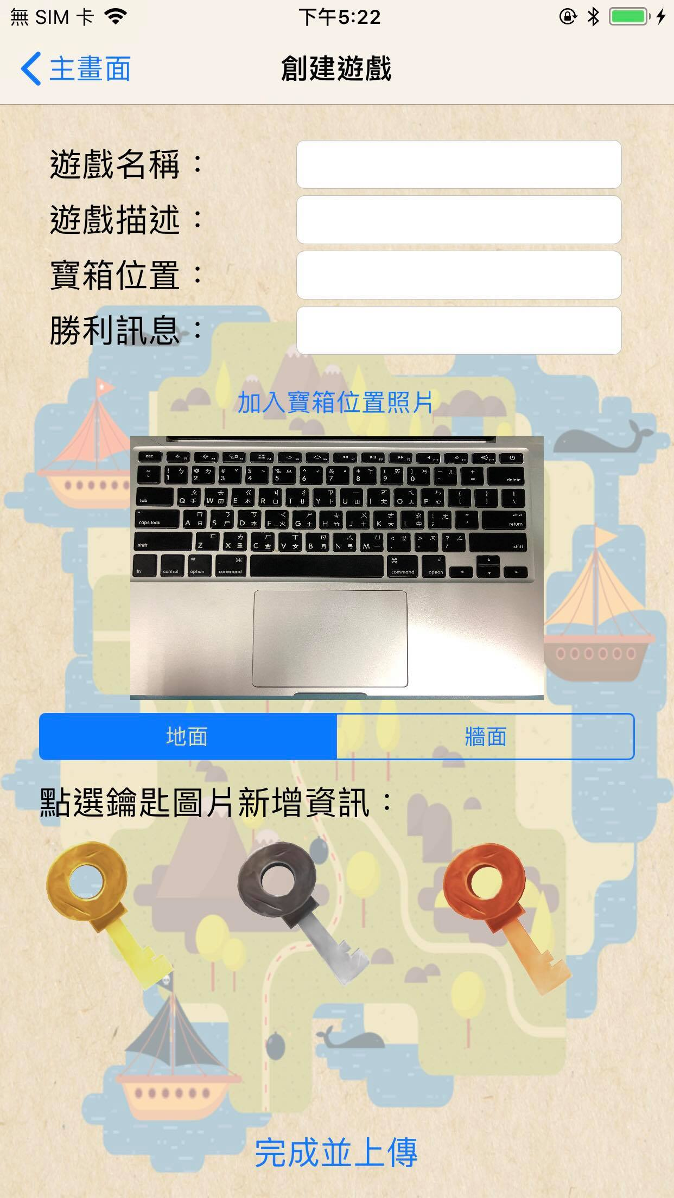
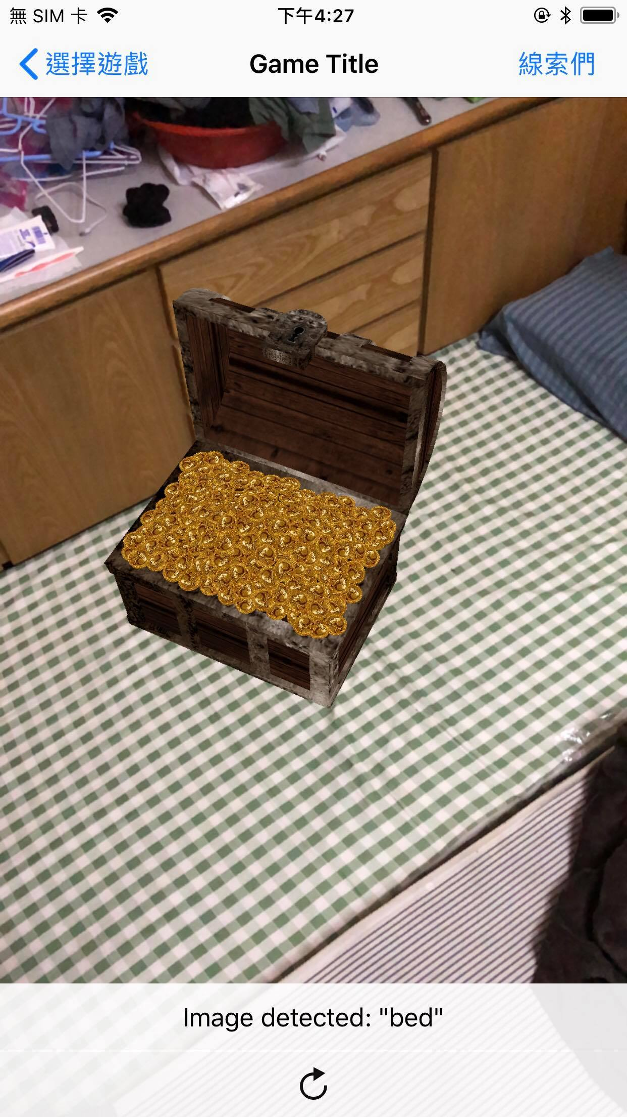
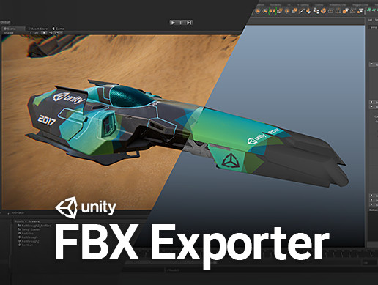




treAsuRe hunting
Hao-Cheng Wang, Yi-Hsuan Lee, Sheng-Yeh Chen
National Taiwan University Computer Science & Information Engineering
Introduction
At the key point 1
Where one can get the Gold key
Back to the starting point
One can now open the treasure box and see the winning message
At the starting point
Where one can see a treasure box
Looking for the keys
According to the clues in the list of clues, one can start to find the keys to open the treasure box.
At the key point 2
Where one can get the Silver key
At the key point 3
Where one can get the Copper key
Technique
Related Application
ARImageAnchor Information about the position and orientation of an image detected in a world-tracking AR session.
Firebase Storage
Exporting model from Unity
SceneKit support 3D model: .obj. & .dae & .scn
Asset Store – FBX Exporter to .fbx
3ds Max, Maya(Payment)/AutoDesk - FbxConverterUI
【WEJUMP】城市尋寶影片Demo（AR擴增實境）
marq - 2013年TGS台北國際電玩展「藏寶AR擴增實境蒐集遊戲」
(a)
(b)
Game Display
Future Work
This work is now just designed so simply that we still have some room to improve and make this app more perfect and more fascinating to people. There are something that we expect to do:
Customized map: In this work, we decided 3 locations for keys and 1 location for treasure. After finding the location of treasure, the player will get the 3 clues for the locations of keys. Once getting 3 keys, the player could win the treasure. To make this work more interesting, we hope in the future, the player could design his/her own rule in this app. For example, the player could set there are 4 keys (3 are real, and 1 is fake) and treasure, and specify that must find 2 keys first(the real keys) to get the other clues for the key and treasure.
Selection of the model: There are only keys and treasure in our model. In the future, we want add more models such as gem, gold, diamond.
Scoreboard: This app is console game. In the future, we could make it be an online game. The player could compete for finding the treasure first, and the time from starting the game to finding out the treasure will be recorded to rank on the scoreboard.

